Slide 1

Bike Rental Demand & Usage Analysis
This report explores bike rental usage by analyzing historical data to understand demand changes over time. It combines time-based trends, weather conditions, and user segments to uncover meaningful patterns.
Adiesh Koul

Slide 2

Project Objectives
Demand Trends
Understand bike rental demand trends over time.
Peak Usage
Identify peak usage times and key influencing factors.
Predict Demand
Predict future rental demand for operational planning.
Recommendations
Offer practical recommendations for improved operations.

Slide 3

Dataset Overview
The dataset includes approximately 1,000 records of bike rental activity.
Time-related details: Date, day, hour, weekday, holidays.
Weather conditions: Type, actual and perceived temperature, humidity, wind speed.
User segments: Casual and registered users, total rentals.

Slide 4
Data Cleaning & Preparation
01
02
03
Eliminate Duplicates
Standardize Data Types
Address Missing Values
Identified and removed redundant records to ensure data uniqueness.
Ensured consistent date formats and validated appropriate numeric values.
Imputed averages for numerical fields and removed any illogical or anomalous records.
04
05
Validate Data Consistency
Engineer New Features
Cross-verified casual and registered user counts for accuracy and alignment.
Derived additional columns, such as weekday/weekend indicators, for deeper analytical insights.

Slide 5

Methodology & Dashboard Design
Analysis Tools
Pivot tables for aggregation and slicing.
Excel charts for trend and comparison analysis.
Forecasting techniques using Excel’s built-in functions.
Dashboard Features
Interactive slicers for time, weather, and user type analysis.
Charts respond instantly to applied filters.

Slide 6
Key Performance Indicators (KPIs)
Total Visitors
Registered Visitors
Casual Visitors
Overall rental volume.
Registered user rentals.
Non-registered user rentals.
Avg. Visitors/Day
Peak Hour
Busiest Day
Daily average rentals.
Busiest rental hour.
Highest rental day.
Weekday Visitors
Weekend Visitors
Visits during Weekday
Visits during Weekend

Slide 7
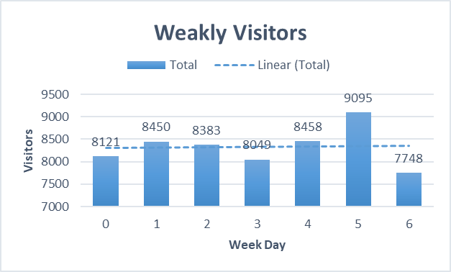
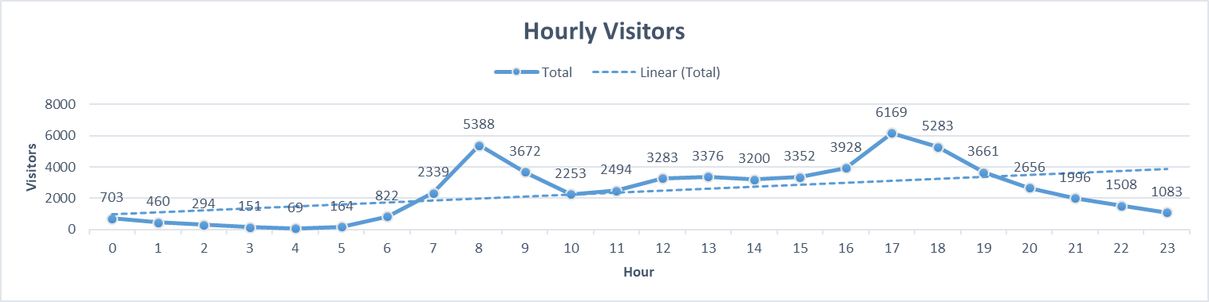
Demand Trends: Weekly & Hourly
Weekly Visitors
Hourly Visitors
Visitor traffic is not evenly distributed, with higher demand on certain weekdays.
Clear peak observed during specific hours, indicating rush-hour usage.

Slide 8
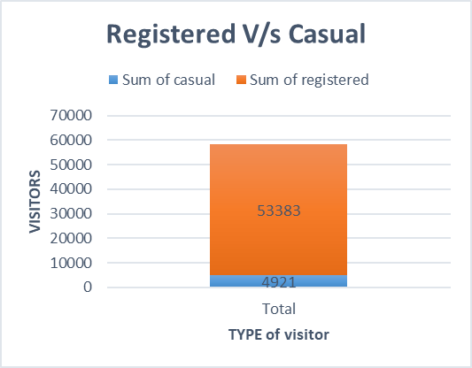
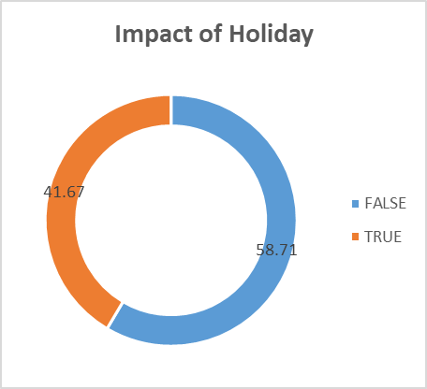
User Segments & Holiday Impact
Registered vs. Casual
Holiday Impact
Registered users contribute the majority of total rentals, while casual users form a smaller segment.
Visitor volume differs significantly between holidays and normal days, impacting demand.

Slide 9
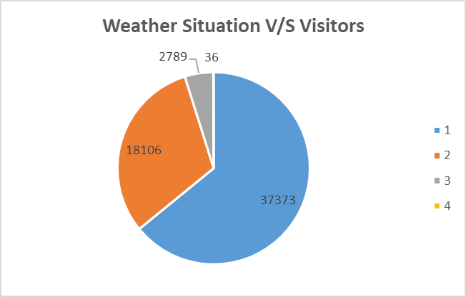
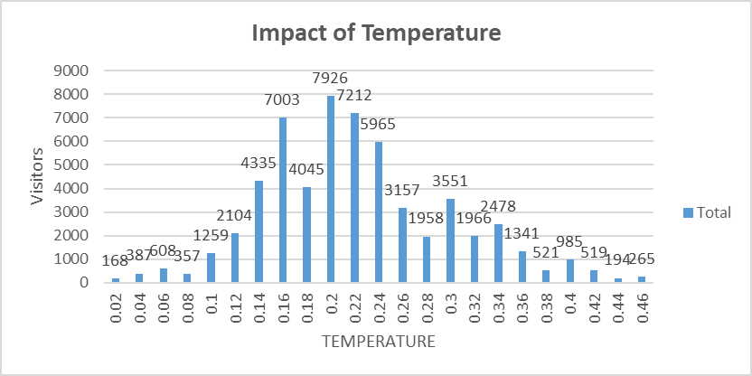
Weather & Temperature Influence
Weather Situation
Temperature Impact
Certain weather conditions attract higher bike usage; adverse weather reduces rentals.
Moderate temperatures show higher rental activity; extreme temperatures reduce usage.

Slide 10

Key Findings & Conclusion
Demand Drivers
Strongly influenced by time, weather, and user type.
User Behavior
Registered users dominate; casual demand varies with weather.
Usage Patterns
Peak hours and weekdays show higher rentals; late nights are low.
Predictable Future
Overall visitor demand remains steady, making future usage predictable.

Slide 11
THANK YOU

